Slide 1
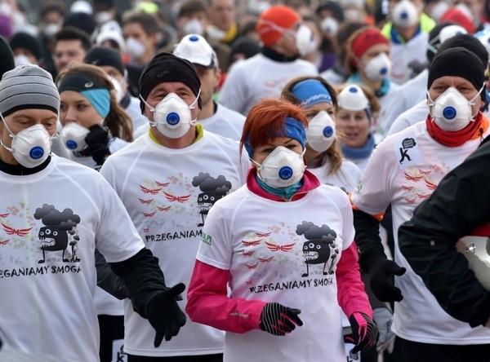
Project title - Relax or Run
Team ID: Fun Factory / Lets Try / We will find out / Be who you want / Snow Ball

Slide 2
Relax or Run
Project title: Relax or Run
Team ID: For Fun Team / Lets Try / We will find out / Be who you want / Snow Ball
Description of the target project: Application for runners that will allow you to limit contact with the smog. The application allows you to set the route with minimalization of the smog (Our application will use the data sent by Airly sensors. Airly sensors measure the concentration of particulate matter PM1, PM2.5 and PM10 in real time and the most important weather parameters giving information about the air quality in the location where they are located) and road pollutants.
Description of realized project: Application that will measure the level of air pollution you faced during your run. Program is written in java enviroment and desingned for android users. It needs access to gps location and internet. App starts when you press start on the screen. It makes the enquiry about coordinates every 10 seconds. On this basis app estimates level of air polution at this moment. After pressing finish on the screnn app summarize the run and show the avergage level of air polution.
What specific changes in the human body are caused by prolonged exposure to unhealthy air? • Respiratory changes - trouble breathing, wheezing, bronchitis and pneumonia, coughing and asthma attacks, etc. • Problems absorbing oxygen in the blood causing diseases of the circulatory system and central nervous system • Decreased resistance to various types of infections (the human immune system is very weak) • Damage to internal organs such as the kidneys, liver, adrenal glands, but also bones • Fertility issues • Accumulation of dirt in the body can cause cancer.

Slide 3
Relax or Run
On the basis of traffic volume and air quality data you can calculate a safe route to run. It will be your advisor who will help you decide to stay or run. The app will check whether in the current conditions you will harm yourself or help. If you have any harm by running, then you better stay at home and play chess or go to the gim or pool. The application will also allow you to enter comments about the route traveled (risks – ex. bad smells, angry dogs, crazy bikers and benefits – ex. nice viev); you can find the type of route (normal, cross-country); type of surface (asphalt, ground).
STEPS:…….about how we did it
Built with: Python 3; Java; Android 7.1;
Data sources: ….
Recipient: running enthusiasts;
Demo link: …
Repository link: …

Slide 4
Relax or Run
What the project gave us ? New: experience, ideas, friendships.
Summary If you never try You’ll never know We can do it ?! ☺
Why we did it? We like challenges, fun and development.

Slide 5
Relax or Run
Our story;
It is ours first time;
So we did our best ☺ ☺ ☺;
Lucky we ☺ ☺ ☺.

